Slide 1





Dawood University of engineering & technology
Pakistan Studies Presentation
Initial Problem Of Pakistan
presented by:
Hira Fatima (25F-AI-096)
Hafsa Fatima (25F-AI-83)
Bisma Tariq (25F-AI-094)
Department: Artificial intelligence
Section: A2/B
Instructor:
Sir Faisal

Slide 2
INDEX OF TOPICS
Introduction
Refugee Problem in Early Years of Pakistan
Choice of Capital and Establishment of Government
Unfair Boundary (Radcliffe Award
Division of Military Assets
Division of Financial Assets
Economic Problems
Issue of National Language
Electricity Problem
Kashmir Dispute
Canal Water Dispute
Constitutional Problem
Conclusion
01

Slide 3
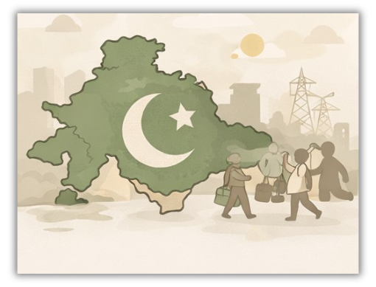
INITIAL PROBLEM OF PAKISTAN
Introduction:
Pakistan came into being on 14 August 1947. At the time of independence, Pakistan faced many serious problems. These problems were political, economic, social, and administrative. As a new country, Pakistan had limited resources and weak infrastructure. The early leadership had to work very hard to solve these issues.
02

Slide 4
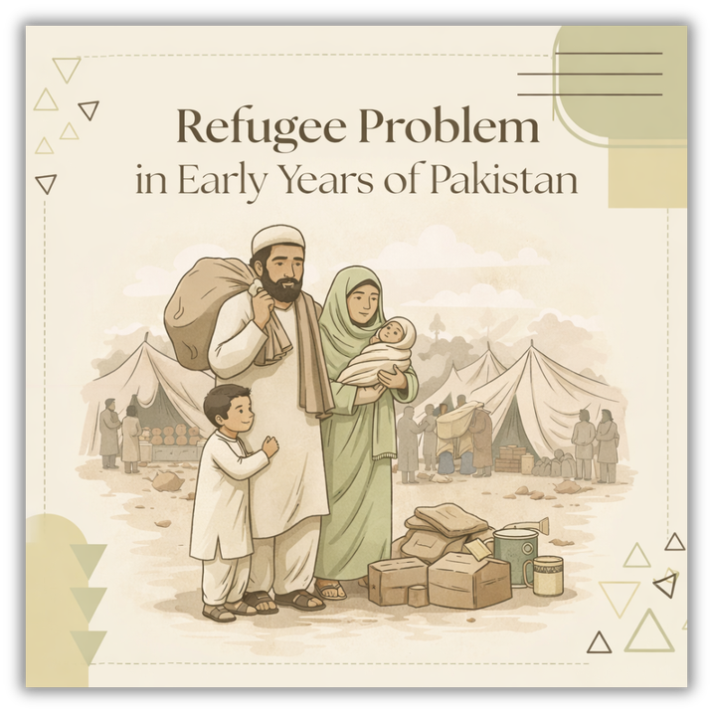
Refugee Problem in Early Years of Pakistan
At the time of independence in 1947, Pakistan faced a severe refugee problem as millions of Muslims migrated from India to Pakistan. These refugees arrived with little or no belongings, creating a huge burden on the government. The administration had to urgently arrange food, shelter, and employment for them. Cities like Karachi became overcrowded, and resources were limited. Refugee camps were set up, but living conditions were often poor. This sudden population increase created serious administrative, economic, and social challenges for the newly established state.
03

Slide 5

Choice of Capital and Establishment of Government
At independence, Pakistan did not have a proper capital city. Karachi was selected as the temporary capital. There were very few government offices and buildings. Pakistan also had a shortage of trained staff and experienced officers. Setting up a new government system was a big challenge.
04

Slide 6
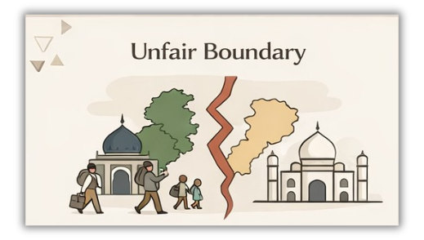
Unfair Boundary (Radcliffe Award)
The boundary between India and Pakistan was decided by the Radcliffe Commission. Many Muslim-majority areas were given to India, including Gurdaspur. This created anger and problems for Pakistan. The unfair boundary also caused violence and migration issues.
05

Slide 7
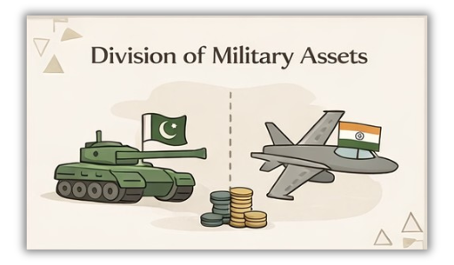
Division of Military Assets
After partition, the military assets of British India were divided between India and Pakistan. Pakistan received fewer weapons, equipment, and military bases. This made Pakistan’s defense system weak in the beginning. It created security problems for the new country.
06

Slide 8
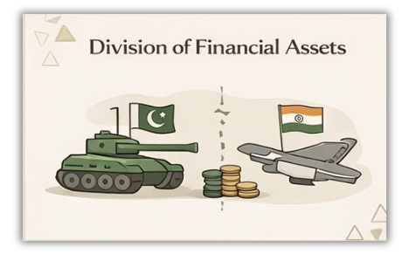
Division of Financial Assets
Pakistan was supposed to receive 750 million rupees from India. However, India delayed the payment and initially gave only a small portion. Due to lack of money, Pakistan faced serious financial difficulties. The government struggled to manage expenses.
07

Slide 9

Economic Problems
Pakistan inherited very few industries. Most industries were located in India. There was a shortage of factories, banks, and business centers. The country mainly depended on agriculture. This made economic development slow in the early years.
08

Slide 10
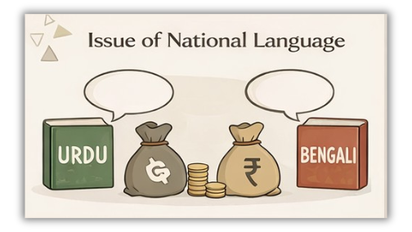
Issue of National Language
Pakistan had many regional languages like Punjabi, Sindhi, Balochi, and Pashto. The government declared Urdu as the national language. However, people in East Pakistan demanded Bengali as well. This language issue later created political tensions.
09

Slide 11

Electricity Problem
At independence, most power stations were in India. Pakistan had limited electricity supply. Industries and homes faced power shortages. This slowed down industrial and economic growth.
10

Slide 12
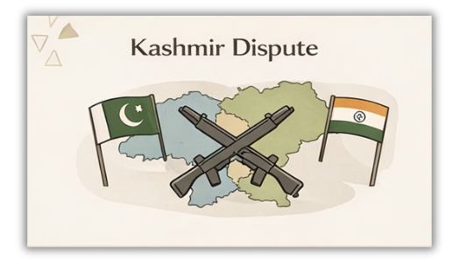
Kashmir Dispute
The ruler of Kashmir was a Hindu, but the majority population was Muslim. The Maharaja decided to join India, which Pakistan did not accept. This led to the first war between India and Pakistan in 1948. The Kashmir issue remains unresolved even today.
11

Slide 13
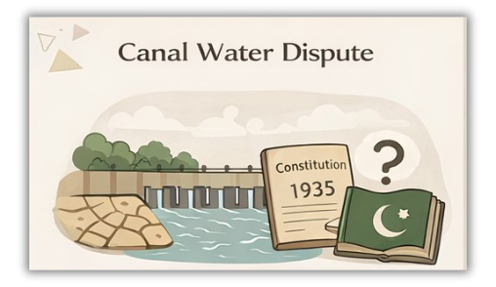
Canal Water Dispute
Most rivers of Pakistan originated from India. India stopped the water supply of some canals. This created serious agricultural problems for Pakistan. Later, the Indus Waters Treaty (1960) was signed to solve this issue.
12

Slide 14
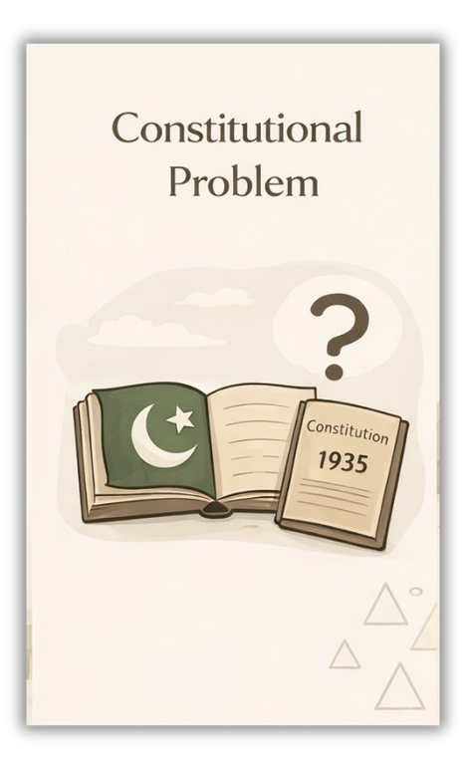
Constitutional Problem
At independence, Pakistan did not have its own constitution. It used the Government of India Act 1935 temporarily. Making a new constitution was difficult due to political differences. Finally, Pakistan introduced its first constitution in 1956.
13

Slide 15
Conclusion
In conclusion, Pakistan faced numerous initial problems at the time of its creation in 1947, including the refugee crisis, lack of administrative structure, economic instability, and shortage of resources. Despite these severe challenges, the country showed resilience and determination. Through strong leadership, especially under Quaid-e-Azam Muhammad Ali Jinnah, Pakistan gradually overcame these difficulties and laid the foundation for a stable and independent state
14

